Slide 1

Conference Paper Session 11
EPlus-LLM: A Novel Automated Building Simulation Platform Using Natural Language
Gang Jiang, The university of Utah
Liang Zhang, The University of Arizona
Jianli Chen, The University of Utah, jianli.chen@utah.edu

Slide 2
Learning Objectives
After attending this session, the attendees will be able to explain the importance of analyzing and predicting miscellaneous electric loads (MEL) in buildings, particularly in educational settings, considering their significant contribution to energy consumption and the challenges associated with occupant-centric usage patterns.
After attending this session, the attendees will be able to compare and contrast the performance of three distinct deep learning models—Long Short-Term Memory (LSTM), a simple deep neural network model, and Bayesian LSTM—in accurately forecasting MEL in an educational building case study, with emphasis on predictive accuracy, and performance.
After attending this session, the attendees will be able to identify and describe the benefits of monitoring and forecasting the energy impacts resulting from performance degradation and improvements in rooftop units (RTUs).
After attending this session, the attendees will be able to explain how feature engineering can be used to create additional features for use in data-driven modeling from existing raw data variables.
Identify challenges and transformational opportunities in artificial intelligence-enabled building commissioning.
Determine important factors that need to be considered to effectively and successfully implement artificial intelligence and digital practice in the building commissioning process anywhere.
Learn how to process dataset for building auto-modeling tasks
Learn how to use large language model with natural language for building applications, e.g., auto-building modeling

Slide 3
Acknowledgements
We would like to acknowledge the funding provided by the US National Science Foundation (NSF). Award title: Elements: A Convergent Physics-based and Data-driven Computing Platform for Building Modeling (#2311685).

Slide 4

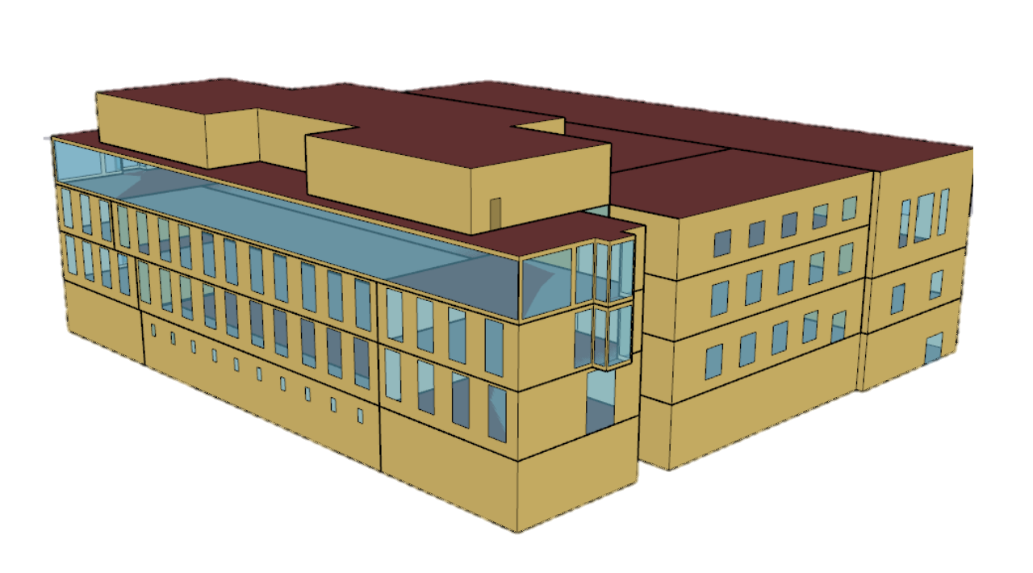

Introduction
Building accounts about 36% of global energy consumption
Building energy modeling is an important tool to support various building energy efficiency applications, e.g., retrofits, sustainability, and decarbonization
Buildings (35.4%)
Other Sectors
Support
Energy Efficiency
Building Energy Modeling
Control

Slide 5


Motivation
GUI: OpenStudio
Software familiarity
Assigning tons of settings and parameters
Building Energy Modeling
Time-consuming
Knowledge-intensive
PyPackage: Eppy
Coding skills
Manual modifying
Notes:
Ok I think any modeler are all annoyed with the building modeling, especially as a beginner.
Have succeed in the NLP field
May also provide new insights and opportunity in building modeling

Slide 6



Motivation
GUI: OpenStudio
Software familiarity
Assigning tons of settings and parameters
Building Energy Modeling
Time-consuming
Knowledge-intensive
PyPackage: Eppy
Coding skills
Manual modifying
Large Language Model
Be pre-trained to capture contextual information within natural language
Billions of parameters with fine-tuning to handle specific downstream tasks
NLP tasks: QA, Summary, Translation, etc.
Other applications: Medical assistant, consultor, etc.
Notes:
Ok I think any modeler are all annoyed with the building modeling, especially as a beginner.
Have succeed in the NLP field
May also provide new insights and opportunity in building modeling

Slide 7

Motivation
GUI: OpenStudio
Software familiarity
Assigning tons of settings and parameters
Building Modeling
Building Energy Modeling
Time-consuming
Knowledge-intensive
PyPackage: Eppy
Coding skills
Manual modifying
Auto-building Modeling Platform
Language Ability
Large Language Model
Be pre-trained to capture contextual information within natural language
Billions of parameters with fine-tuning to handle specific downstream tasks
NLP tasks: QA, Summary, Translation, etc.
Other applications: Medical assistant, consultor, etc.
Human-AI interface via natural language
Reduce various of modeling efforts
Notes:
Ok I think any modeler are all annoyed with the building modeling, especially as a beginner.
Have succeed in the NLP field
May also provide new insights and opportunity in building modeling
我们希望结合二者来提高建模的效率，减少建模的efforts
我们提供了一个人机交互页面，用户可以使用自然语言进行自动仿真，这大大减少了仿真的efforts

Slide 8
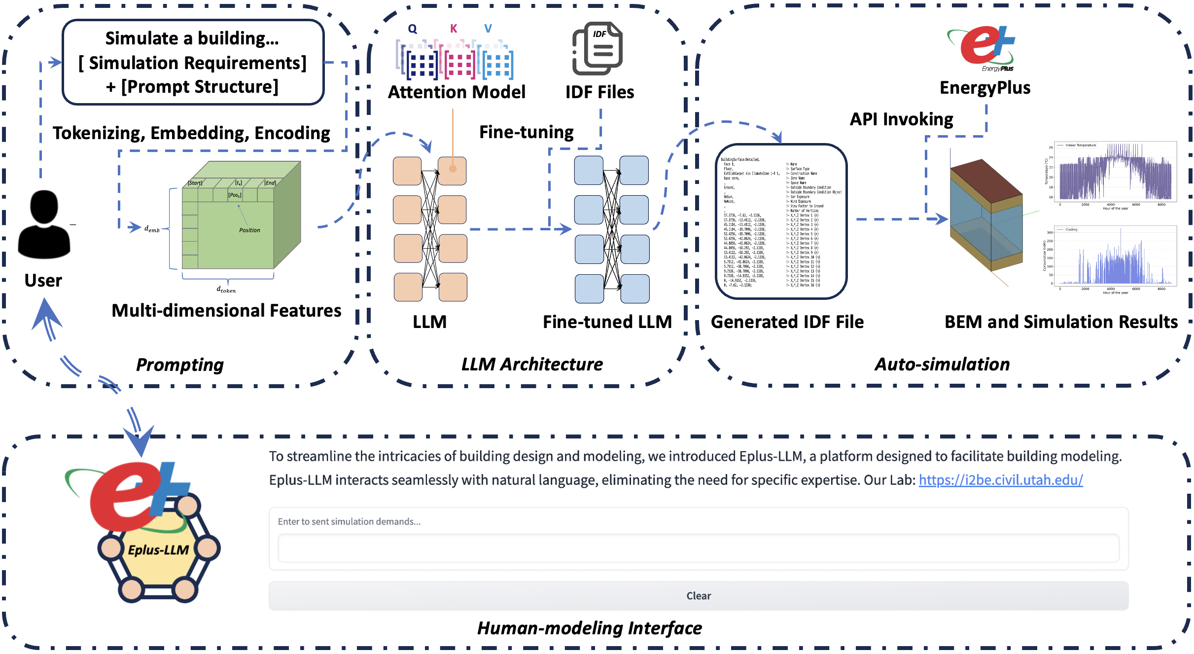
EPlus-LLM Framework
How to realize?
Dataset for LLM customizing in auto-building modeling (How)
LLM architecture for building modeling (To)
Demo of generating IDF by language via human-AI interface (Realize)
Eplus-LLM framework
Notes:
There steps for applying llms in the building modeling
Next page 搭建framwork costimuze llm
First step of Costimization : trainig dataset
Second: llm architecture
Our platform: demo
(1) How to let llm have specific abilities, like to learning some thing
(2) How to applied and why it can work
(3) Presentation

Slide 9




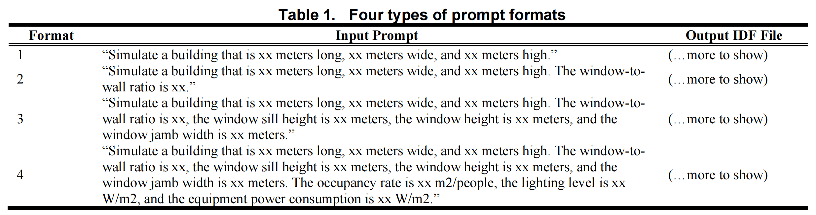
Dataset for LLM Customizing
Design prompt as input, IDF file as output
Step1: Parameters-IDF scenario pairs
Step2: Descriptions-IDF sentence pairs
Sampling modeling parameters
Prompt format
Corresponding IDFs
Collecting IDFs
Self-learning ability, e.g., understanding unseen prompts, typos
70,000 prompt-target pairs with 4 prompt format, running 2 epoch

Slide 10
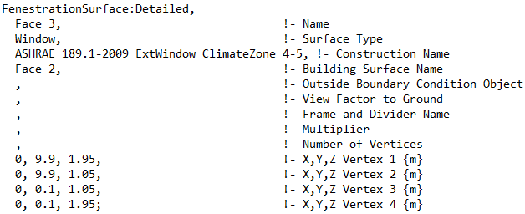

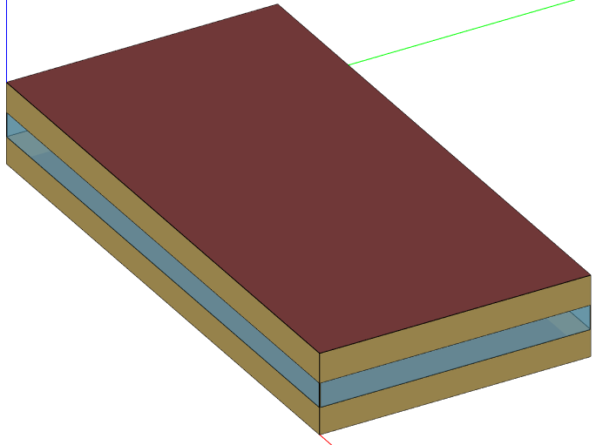


Example of prompt-IDF
Window simulation setting
“Simulate a building that is 20 meters long, 10 meters wide, and 3 meters high. The window-to-wall ratio is 0.3, the window sill height is 7 meters, the window height is 14 meters, and the window jamb width is 0.1 meters. The occupancy rate is 10 m2/people, the lighting level is 4 W/m2, and the equipment power consumption is 5 W/m2.”
Window geometry information, described by coordinates
User
IDF window part corresponding to the prompt
Wall position couple with other wall, roof, and window position, described by coordinates.
Window position couple with their wall position, described by coordinates.
Building internal loads, lighting, equipment, occupant, etc. Equip.

Slide 11
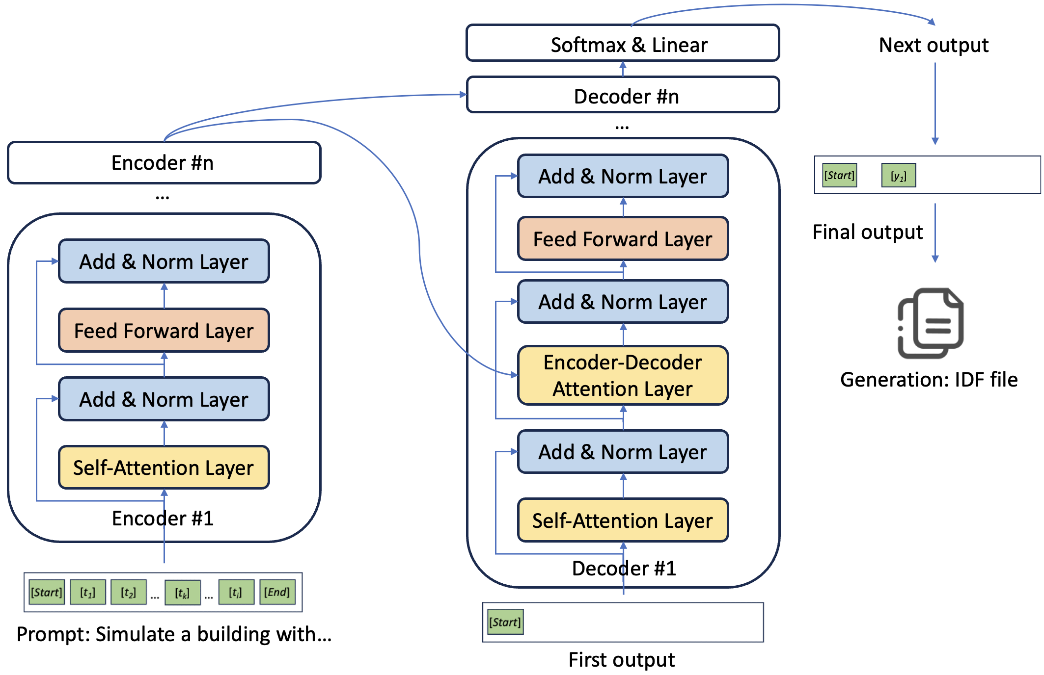
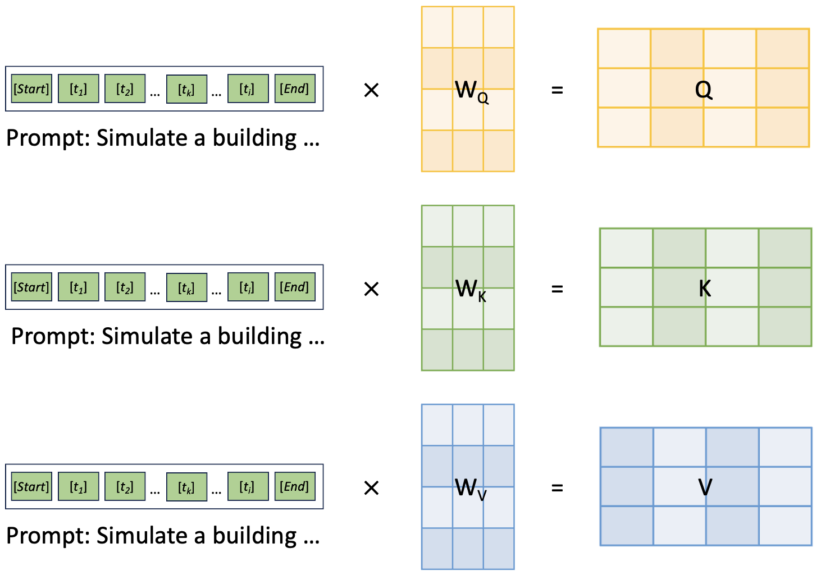
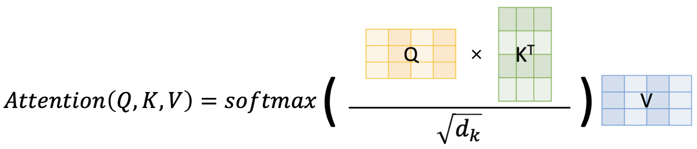
Large Language Model Architecture
Attention mechanism in building modeling
Map building modeling prompt to model in IDF
Capture parameter coupling relationships and dependencies.
Focus on importance of user input in building modeling, e.g., lighting level, 6 W.
Attention: Specific information the model is focusing on
LLM architecture: Transformer-based T5

Slide 12
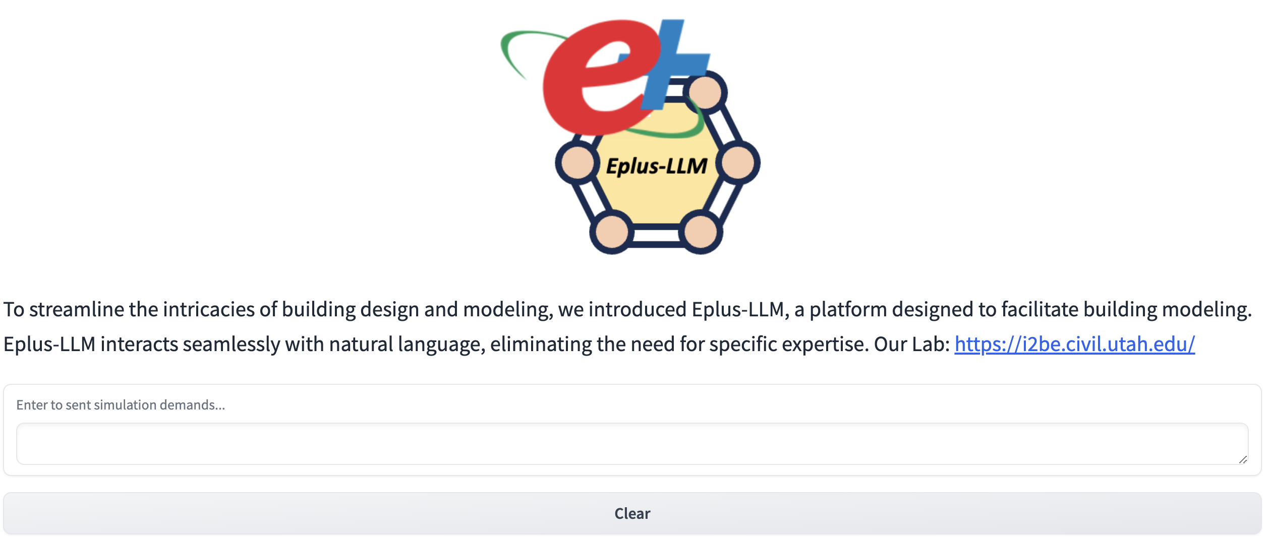
Demo Presentation
https://105fc27376eabb684d.gradio.live

Slide 13
Conclusion
Eplus-LLM is the first platform for realizing auto-building modeling via natural language
Eplus-LLM provides a human-AI communication way to reduce the efforts of modeling
Validation part confirms accuracy and robustness of Eplus-LLM

Slide 14
Limitation and future work
Limitation
Only able to handle relatively simple modeling cases under regular settings.
Unable to process interdependencies such as “placing this window in the xxx position of the south wall”.
Future work
Exploring and applying LLMs for more real-world building modeling scenarios.
Appling LLMs in other building applications.
Notes:
Our work serves as a pioneering work to see the potential application and oppynity of llm in the buiding field.
We have limitations and future work to do.
Only able to handle relatively simple modeling cases under regular settings (e.g., rectangular building shape with WWR) as representative examples due to current objective conditions
Unable to process interdependencies such as “placing this window in the xxx position of the south wall” since it requires the LLM to obtain more semantic information and make corresponding changes.
In practical building modeling, various systems with complex geometries, different zones, and schedules are expected, requiring a further enhancement of the developed platform for automated modeling. Moreover, our platform has not been able to process interdependencies such as “placing this window in the xxx position of the south wall” since it requires the LLM to obtain more semantic information and make corresponding changes.
Future research directions will include further exploring and applying LLMs to enhance their potential in various real-world applications. We advocate for investigations on more flexible and complex modeling scenarios, such as buildings with complex zoning or prompts for auto-modeling containing semantic description of buildings (e.g., south/north wall).

Slide 15
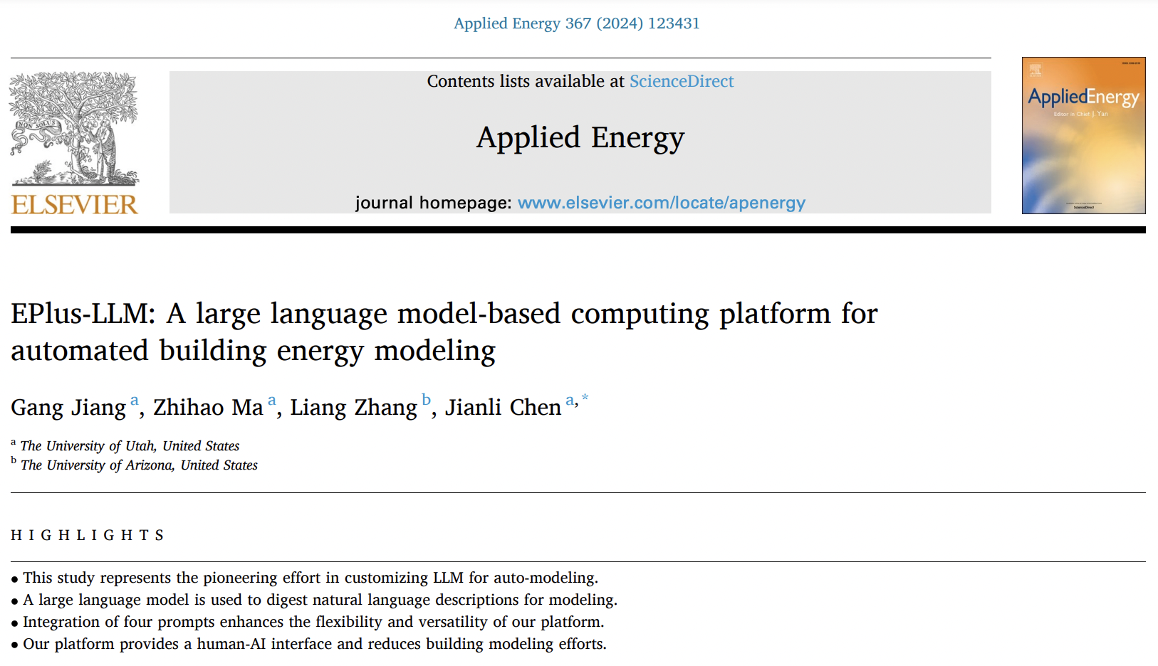

Questions
Jianli Chen
jianli.chen@utah.edu
The corresponding publication in the AE journal

